Slide 1
IAM
Scoping

Slide 2
Context and Pain points
IGA ambitions
Scenarios

Slide 3
IAM : Global overview
Employees & on-site Externals (B2E)
Governance
Administrators (PAM)
Employees are managed by HR services.
Service providers are managed by managers
Users who by their privileges possess extensive accesses in the IS and require additional protections.
Manage
Identities
Co-contractors
IAM
Co-contractors are granted specific accesses on BYCN IS
Manage
Authorization
IAM
Manage
Authentication
Customers (CIAM)
Manage authentication and access for unmanaged identities
Suppliers & partners (Guest/B2B)
Partners identities are managed by their own compagnies
Notes:
3 pilliers de l'IAM :
Manage identities
Manage authentication : gestion de l'authentification des utilisation
Manage authorization : gestion des droits des utilisateurs
L'IAM pour qui :
Les employées et prestataires
Les co-contractants
Les sous-traitants et partenaires
Les administrateurs
Les clients

Slide 4

IAM : Global overview
Employees & on-site Externals (B2E)
Governance
Administrators (PAM)
Enhance high privileged account management and secure secrets through a bastion such as CyberArk. A PAM Program* will start on Q1 2023.
Employees are managed by HR services.
Service providers are managed by managers
Users who by their privileges possess extensive accesses in the IS and require additional protections.
Manage
Identities
Co-contractors
IAM
Co-contractors are granted specific accesses on BYCN IS
Manage
Authorization
IAM
Manage
Authentication
Customers (CIAM)
AD & Azure AD
Manage authentication and access for unmanaged identities
Suppliers & partners (Guest/B2B)
At this time, no customers in BYCN IAM environment
Ongoing project of management of partners with the Migration from BCC to Azure B2B
Partners identities are managed by their own compagnies
Notes:
Pour certaines populations et ou blocs de l'IAM des initiatives en cours chez BYCN
Partners & Guest : migration depuis le portail BCC vers Azure B2B
Pour les administrateurs : la solution CyberArk et des évolutions prévues de démarrer au 1er trimestre 2023
Pour la populations des clients : cette population n'est pas présente dans l'environnement BYCN
Enfin, pour le sujet spécifique de l'authentification le sujet est porté par l'AD & Azure AD

Slide 5
Focus on Employees vs Suppliers / partners / B2B
Employees & on-site Externals (B2E)
Suppliers & partners (Guest/B2B)
The Manager:
Manage the Identity of the employee;
Define the authorizations of the employee from an employee centric view
The Identity lifecycle of the Partner is managed externally by its company (beware of personal mail address)
Authorizations are managed locally by resources owners from a resource centric view
But there is a graduation between those extremes!
And bridges are needed…
Global Policies
But different tools…
IGA
Focus on
Identity management
Business view
Profiling, rules…
Azure AD B2B
Focus on Resources,
Access re-certification
Notes:
Nombre d’identité = nombre de licence office 365 payées- BYes

Slide 6

IAM : Global overview
The current project is to improve identities & authorization management for
•Employees & on-site externals,
•Co-contractors
This sub-topic of IAM is called Identity Governance & Administration (IGA). It focuses on controlling identities that have to be managed by an organization and their accesses
Employees & on-site Externals (B2E)
Governance
Administrators (PAM)
Employees are managed by HR services.
Service providers are managed by managers
Users who by their privileges possess extensive accesses in the IS and require additional protections.
Manage
Identities
Co-contractors
IAM
Co-contractors are granted specific accesses on BYCN IS
Manage
Authorization
IAM
Manage
Authentication
Customers (CIAM)
Manage authentication and access for unmanaged identities
Suppliers & partners (Guest/B2B)
Partners identities are managed by their own compagnies
Notes:
La mission s'est concentré la gestion des identités et des accès pour les employées & presta ainsi que les co-tractant
Ce sous-domaine de l'IAM s'appelle IGA

Slide 7
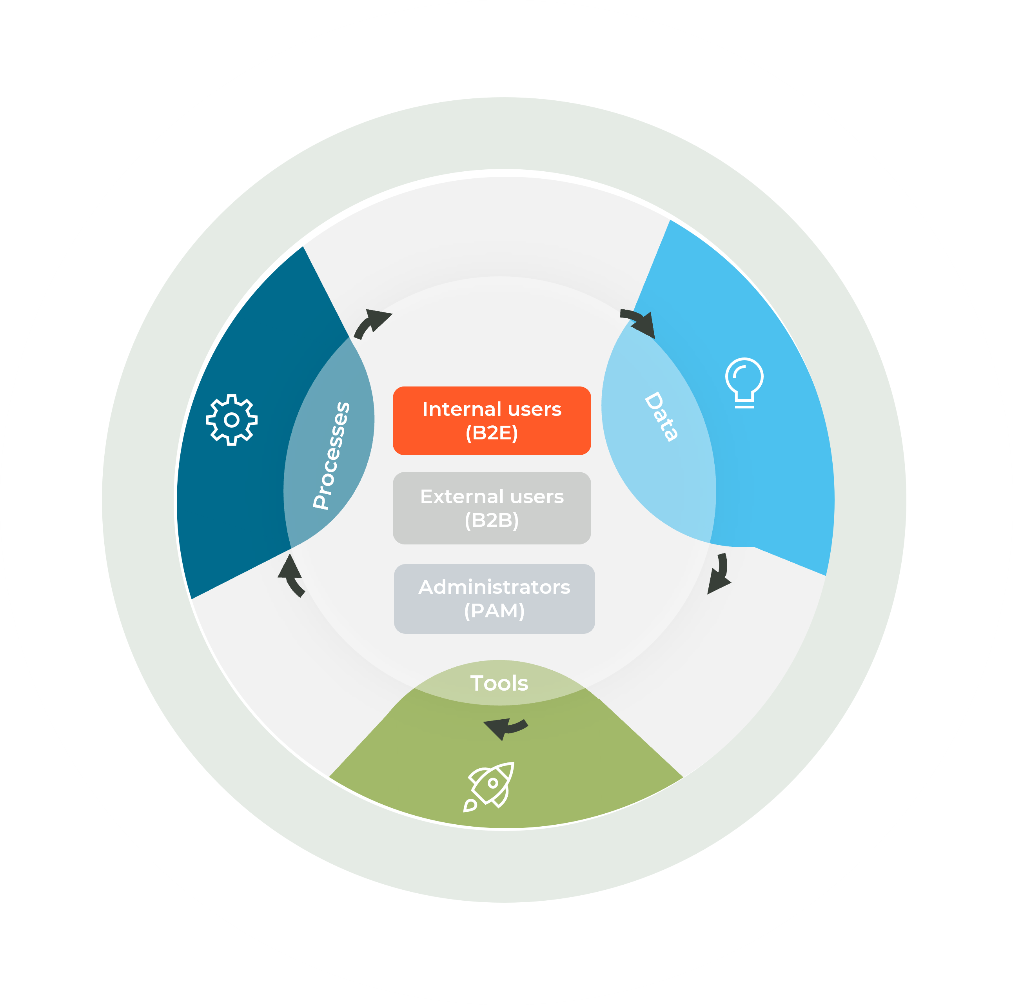
What is Identity Governance & administration (IGA)
Definition:
Ensure that all Information System users can access assets (systems, applications, data) with the necessary and sufficient permissions.
A service at the junction between business and Information Systems
A governance on 3 levels
Business view
Processes
Manage :
Joiners
Movers
Leavers
Authorization
Persons
Organization
chart
Business missions
Master DATA
Use master sources to manage users’ lifecycle and reduce human errors
IGA
Dictionary for identities and accesses
Processes
Reporting
IT view
Tools
Active directory
(Office 365, etc.)
ERP
Other applications
Tools able to manage thousands identities and automate access (de)provisioning & controls
Notes:
Qu'est-ce que l'IGA : L'IGA est à l'intersection est à la jonction entre les métiers et le monde IT
L'IGA va regrouper un ensemble de référentiels (référentiel de personnes, etc.) , processus (entrées, mouvements, sorties) et outils pour accomplir ses fonctions

Slide 8
BYCN current situation regarding IGA
Global key figures impacting IGA
10,5
A large amount of identities
More than 20 000^{(*)} identities are managed worldwide, including 10.000 ^{(*)} only in France
Different lifecycles per population Staff & workers with different lifecycles and needs
An international context
Chorus usage varies between countries/entities .
10,5
Master Data
Processes
Joiner, mover & Leaver processes mainly rely on manual actions with variations from entities & countries
Only two main data sources for internals :
RUBIS (FR scope)
CHORUS (world scope)
Data are uploaded to CHORUS manually & periodically from entities.
10,5
Tools
CPEOPLE to centralize identities
OASIS to register access request & approbation
Active Directory & Azure AD as main technical directories
Local initiative as Trello (UK) to user lifecycle
* Estimated number of identities after BYes carve-out (Guest & Workers are not included)
Notes:
Nombre d’identité = nombre de licence office 365 payées- BYes

Slide 9
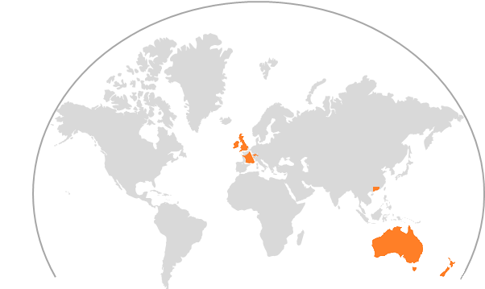
Feedbacks from BYCN Stakeholders
In addition of the interviews conducted in 2021 , ~15 actors from different roles and locations have been consulted to have their feedback
Everyone encounters issues with Identity & Access management and have adapted processes to deal with it.
IT
Process owner
Some issues must be highlighted
HR
Business
Orphan & generic accounts are enabled and not managed that are open doors on our IT
Identity Governance is a requirement for any Zero Trust strategy.
Many manual steps for joiner
Input errors lead to time-consuming operations to correct
Impact on business & user satisfaction
Joiner process too long for certain populations :
Accesses for short-term actors are given with generic accounts
Access to HR apps for entities in CHORUS
Difficulties to manage licenses and revoke them when no longer needed
Countries : UK, Switzerland, Australia, HK, France

Slide 10

HOW IGA WORKS ? GLOBAL OVERVIEW
Identity
Management
Authorization
Management
Applications integration
Integrate users and organization data
Keep users’ information up to date
Grant accesses with rules and roles
Implement workflows when needed
Get applications data
(de)provision accounts & accesses directly or via ticket
Governance
Execute controls to validate accesses and provide KPIs
IGA main features
Notes:
Parler des exceptions qui pose problème aujourd'hui :
Exception positionné mais jamais retirer, manque de gouvernance

Slide 11






HOW IGA WORKS ? GLOBAL OVERVIEW
Business View
Persons
Business missions
Project
Master sources
Unmanaged
Master sources
Unmanaged
Master sources
Unmanaged
Identity
Management
Authorization
Management
Applications integration
Integrate users and organization data
Keep users’ information up to date
Grant accesses with rules and roles
Implement workflows when needed
Get applications data
(de)provision accounts & accesses directly or via ticket
Governance
Execute controls to validate accesses and provide KPIs
IGA main features
Legend
Automatic synchronization
Manual creation
Notes:
Parler des exceptions qui pose problème aujourd'hui :
Exception positionné mais jamais retirer, manque de gouvernance

Slide 12
HOW IGA WORKS ? GLOBAL OVERVIEW
Business View
Persons
Business missions
Project
Master sources
Unmanaged
Master sources
Unmanaged
Master sources
Unmanaged
IT View
Identity
Management
Authorization
Management
Applications integration
Business Applications
Integrate users and organization data
Keep users’ information up to date
Grant accesses with rules and roles
Implement workflows when needed
Get applications data
(de)provision accounts & accesses directly or via ticket
Technical Directories
Governance
Execute controls to validate accesses and provide KPIs
ITSM
IGA main features
Legend
Automatic synchronization
Manual creation
Notes:
Parler des exceptions qui pose problème aujourd'hui :
Exception positionné mais jamais retirer, manque de gouvernance

Slide 13

How IGA works ? More detailed view
Employees
repository
Project & Worksite
Organization
sources
Business role catalog
Applications
Integration
Technical Directory
Identities management
Authorization management
Office 365
Collectors
ERP
Organization directory
Reconciliation
Other global apps
Provisioners
Local apps
Project & Worksite
directory
Automatic rules
Role model
Roles based rules
HR Managed User
directory
White-page directory
Exemptions
HR unmanaged user directory
Approbation
Exemption
Non-HR user directory
Manual /
Exemption
ITSM
manual entries
Other global apps
Identities
re-certif.
Accounts
re-certif.
Access
re-certif.
Gap
mngt
Reporting
Local apps
Legend
Master source
Applications
Governance
IGA capabilities
Support application

Slide 14
To be efficient an IGA program must include evolutions for joiner/Mover/leaver processes
In order to enable the IGA program to meet its expected goals joiner / mover / leavers must be reviewed to place master sources as entry point for the IGA and complete their respective scope to ensure on-time access provisioning and removal.
Joiner process
Enable HR sources to pilot IAM actions for internal populations
Mover process
Process evolution in order to limit accesses accumulation by removing access linked to previous job and/or scope.
Leaver process
Process evolution to remove all accesses and devices at time of user’s departure
Population to consider
Staff
Workers
On-site externals & Co-contractors

Slide 15
FoUR scenarios identified to implement IGA in BYCN
Assessment criteria
#1.A DEDICATED IGA SOLUTION
# 1.B Specific module
Identity Management capabilities
Authorization Management capabilities
Synchronization & Provisioning
Governance
Security
Cost Build
Cost Run
Market-based solutions
Leverage a tool specialized in all four functional aspect of IGA to implement the program
Leverage a module from existing solution in BYCN to implement part or the entire program.
#2.A CPEOPLE Evolution
#2.B New Development
BYCN-developed solutions
Increase CPEOPLE capabilities in Identity management and process technical debt
Develop a new tool up-to-date with security standards to manage identities in the IGA program

Slide 16
EXCLUSION OF TWO SCENARIOS DUE TO LIMITATIONS
#1.A DEDICATED IGA SOLUTION
# 1.B Specific module
Limited coverage
Only two tools have been identified with capabilities in all 4 four aspects of IGA but they are only covering their technical scope (Microsoft, SAP)
Market-based solutions
Leverage a tool specialized in all four functional aspect of IGA to implement the program
Leverage a module from existing solution in BYCN to implement part or the entire program.
Heavy investment with limited benefits
The investment to process the technical debt of CPEOPLE and develop new functionalities is too important in regard of the IGA benefits for a temporary solution
Estimation around 890 K€
Process technical debt = 500K€ Development & processes evolution = 390K€
#2.A CPEOPLE Evolution
#2.B New Development
BYCN-developed solutions
Increase CPEOPLE capabilities in Identity management and process technical debt
Develop a new tool up-to-date with security standards to manage identities in the IGA program

Slide 17





Focus on scenario #1.A : Dedicated IGA solution
10,5
10,5
Plan
Security
Review IAM policies and processes & select IGA solutions
Integrate IGA with FR & UK HRIS and add externals
Integrate IGA with Active Directory and CPEOPLE
2023
MVP
State-of-the art implementation
2024
Integrate major applications
Start creating roles
Integrate “global users’ repository” and other entities
Increase applications and roles coverage
10,5
Limitations
Extension
Annual license cost
Require support team formation
Less customization
2025
Integration (MVP)
Identity Management
Authorization Management
Limitations
~360 k€
Integrate identities from master source automatically
Integrate identities manually for unmanaged populations
Define rules and roles to automatically grant accesses
Simplify user access request
Change & project management
BUILD
200 K€
Integration
160 K€
Licensing
250 – 300 K€ / year
Applications integration
Governance
Technical
Connect applications to collect data
Create / update / delete accounts according to users’ lifecycle
Controls identities and accesses with campaign certification and tool assistance
Centralized view of users’ accounts
MCO : 50 K€
RUN
Functional
MVP: 100 K€
Notes:
Evolution des processus 50 J.H à 800
Dossier architecture, réseau, machine, etc. : 17 J.H à 800
Recette de l’intégration des identités (UK, FR et exeternes) : 30 J.H à 800
Accompagnement au changement : 40 J.H à 800
RFP
Pilotage : 20% pour J.H ci-dessus (137 J.H) + 15 J.H de RFP à 800
Estimation price per year for 10 000 identities 25€/identity : 250K€
Estimation price per year for 20 000 identities 15€/identity : 300 K€

Slide 18

FOCUS ON SCENARIO #2.B : NEW BYCN DEVELOPMENT
10,5
10,5
Plan
Security
Revie.w IAM policies and processes
Develop new solution
Integrate FR & UK HRIS and on-site externals
Develop a solution meeting security requirements
2023
MVP
2024
Integrate “global users’ repository” and other entities
10,5
Limitations
Extension
Major improvement only Identity management
Complexity to control end users' licenses
2025
Integration (MVP)
Identity Management
Authorization Management
Limitations
~710 k€
Integrate identities from master source automatically
Integrate identities manually for unmanaged populations
Access request are made for each application
Change & project management
BUILD
230 K€
Development
480 K€
Licensing
N/A
Applications integration
Governance
Technical
Managed AD account deactivation
Provision access manually or via script
Improve identities controls
No access controls & centralized view of user accounts/accesses
MCO : 50 K€
RUN
Functional
MVP: 150 K€
Notes:
Change & project management :
Evolution des processus 50 J.H à 800
Dossier architecture, réseau, machine, etc. : 17 J.H à 800
Recette de l’intégration des identités (UK, FR et exeternes) : 30 J.H à 800
Accompagnement au changement : 40 J.H à 800
Pilotage : Scénario 2.B Développement : 20% pour J.H ci-dessus (137 J.H) + 20% pour 625 J.H de développement
Modification des montants de run technique et fonctionnel suite aux retours de Carine

Slide 19

Scenarios comparison : functional view
Current situation
#2.B New Development
#1.A IGA Solution
Identity Management
Authorization Management
Applications integration
Governance
No changes
Many manual steps in joiners’ processes
Difficulties to remove unused licenses
Orphan accounts
Improvement on identity management
Automate internals identities’ integration
Improvement on identity controls
Ability to cover identities & access (mid-term)
Automate internals identities’ integration
Manage access with roles and rules
(de)Provision access automatically

Slide 20
Scenarios comparison : financial view
Current situation
#2.B New Development
#1.A IGA Solution
No changes
Improvement on identity management
Ability to cover identities & access (mid-term)
Hypothesis
# users : 20.000
#identities creation in CPEOPLE : 12 000 (2022)
Estimated
costs
BUILD : 0 €
Integration : 0K€
BUILD (MVP) : 710 K€
Change & project : 230 K€ management
Development : 480 K€
BUILD (MVP) : 360 K€
Change & project : 200 K€ management
Integration : 160 K€
RUN : 350 K€
Licenses : 0 K€
Technical : 350 K€ (CPEOPLE)
Functional : Unknown
RUN : 200 K€
Licenses : 0 K€
Technical : 50 K€
Functional : 150 K€
RUN : 450 K€
Licenses : 250-300 K€ / year
Technical : 50 K€
Functional : 100 K€
Estimated benefits
N/A
Improvements
Automate processes for identities (internals) (1 manual operation vs 3 actually / scope limited to AD)
Improvements
Automate processes for identities (internals) & accesses Full automation for internals
Users' experience
Enable zero-trust
Accounts & related licenses cleaning
Office 365 licenses : ~50 K€
Accounts & related licenses cleaning
Office 365 licenses : 50 K€
+ Integrated applications RETEX at least 10%o f existing accounts
Notes:
Quelques centaines de licences à 20 euros/mois
200*20*12 = 48 000
Réduction support IT
Amélioration parcours utilisateurs
A voir pour retirer les prix et mettre des gains Zero-trust, sécurité, licence
Rajouter Roadmap scénario IGA

Slide 21
Gartner’S QuotES
“Do not attempt to deploy IGA tools by yourself or with a limited team; expect a significant amount of professional services. […]. Expect long implementation times, augmented by necessary process changes that require executive sponsorship.”
“With the increased threat landscape, more successful IGA adoptions have chosen a bigger focus on security and risk management, instead of process automation.”
“IGA should be deployed using a “broad and shallow” approach, rather than “narrow and deep,” by rolling out “minimum viable” capabilities across multiple target systems for all users, then increasing the depth of capabilities incrementally. […] It is also a best practice to start with higher value governance capabilities, like analytics for flagging dormant and unused accounts, and have automation targeted later in the program, after data quality problems and bigger risks of unnecessary privileges are mitigated.”

Slide 22


Focus on Partners & Guest Management
Context :
BYCN grant access to some of its resources to third-party via guests’ mechanisms (BCC, Azure AD).
Why are Guests’ accounts not usually managed in IGA solutions ?
How BYCN plan to manage these accounts ?
On-going technical initiatives
Migration from users in BCC to Azure Active Directory (AAD) to centralize partners & gests accessing BYCN IS Azure access packages to link users and the applications
Acquisition of additional AAD licenses to enable resource the review partners/guests’ permissions
Guest management characteristics
IGA solution impacts
The number of managed identities significantly increases
In our context, More than 15 000 guests only in Azure, not including BCC users
The needed number of licenses and the overall cost.
More than 200 K€ per year,
Initiatives to start
Processes and policies must be formalized to clearly indicate roles and responsibilities such as :
Reviewer that will periodically controls partners & guests’ accesses
Applications are responsible for creating in AAD their partner/guest users
Training and change management
Estimation 15€/account
Partners & Guests accesses can be granted by anyone in the company (ex : teams)
Complexity and data model maintenance can lead to exploitation overload
BYCN strategy is aligned with the market tendances for the management of its partners and guests

Slide 23

Roadmap for the Scenario #1.A IGA
2023
MVP
2024
2025
Enablers
User registration definition
HR unmanaged identities
Tooling
Automatic FR HR synchronization
RFI /RFP
Product choice / POC
Integrator choice
Automatic Global employees repository synchronization
External FR identities manual entries
Basic joiner access
Initial business roles list
Applicative profiles creation/review new apps
business roles enhancement / add
Publish roles
Applicative profiles creation/review for selected apps
Publish roles
Applications selections & prioritization
AD & CPEOPLE
connectors
New applications integration
Governance
1st and 2nd level (license office 365) new entity users
1st and 2nd level (license office 365) new entity users
IAM policies definition
KPI construction
Sprint definition
1st and 2nd level (license office 365) FR users
3rd level control FR users
3rd level control integrated identities and business roles

Slide 24

Unit of Work : Integration of new identities
Description
Stakeholders
HR / IT / Business manager
Review local J/M/J processes
Extraction Internals and externals
Control data quality
Integrate identities
Validate
Change management
Budget estimation
Product cost
N/A*
Project cost
10-22 K€
Product recurring cost
N/A*
Run recurring cost
N/A
Comments
* Product cost can be reassessed depending on the volume of identities to integrate

Slide 25
Unit of work : Business roles
Description
Stakeholders
IT / Security
For each domain :
Identify 3 to 4 macro business roles per domain
Specify accesses needed per role
Collect in each applicative referential users' permissions (e-g applicative profiles) for the domain
Compare accesses and validate with businesses
Review roles periodically to add/remove access
Budget estimation
Product cost
N/A
Project cost
4,5 K€ / role
Product recurring cost
N/A
Run recurring cost
2 K€ / team
Comments
IGA solution can help by offering a 360° view of user accesses (integrated app)
SAP ECC has defined a list of business roles in its application

Slide 26
Unit of work : applications integration
Description
Stakeholders
IT / Application owner
Simple connector :
Applications for which connectors are already developed
Medium :
Applications with standardized interface (API REST, CSV, SCIM, etc.)
Complex :
Applications that cannot be categorized as simple or medium.
Budget estimation
Product cost
N/A
Project cost
Simple : 1-5 K€
Medium : 10-15 K€
Complex : 15-30 K€
Product recurring cost
N/A
Run recurring cost
N/A
Comments
Costs regarding target application are not referenced here.

Slide 27
Application integration
The development of a connector is made via multiples steps:
Data synchronization
Data quality work
Development and integration
The estimated workload is usually between 2 and 20 man days per connector
Agile methodology for connectors development
Data quality
Deployment
Development
Connector development
sprint
Analysis & history management
Backlog
IGA
scope extension
Product management

Slide 28
General definition
User identity
Applicative profile
A user identity is a physical person (intern, service provider, temp worker, partner, etc.) who by its function require an access.
Set of permissions given in an application
Business role
Identifier
Functional collection of applicative profiles which contains the necessary permissions to perform the activities associated to the role
Unique attribute to identify a user in a system
Identity Governance and Administration
Account
Set of policies, processes and tools to mange users' identities and authorization across the information system
User’s identity for a given system
Authorization
User provisioning
The processes of granting users permissions and verifying them
The processes of creating and modifying a user account in a system
Authentication
User deprovisioning
The processes of verifying account’s authenticity
The processes of de-activating and/or deleting a user account in a system
Least privilege principle
Access model
Principle of granting a user only the permissions required to perform their functions.
Sets of rules defining user permission in function of criteria
Permission
Access recertification
Allowed action for a specific asset (ex: read file, click button, etc.)
Verification that actual users’ permissions are aligned with policies and rules

Slide 29
BYCN Eco-system
Name | Description | Scope
SESAME | Create a unique identifier | Worldwide
RUBIS (SOPRA HR) | HR IS France | France
CHORUS | Synchronize local HR systems in Succes Factor | Worldwide
Success Factor | Database for ByLearn | Worldwide
CPeople / Argos / Community People | User repository | Worldwide
SCO Portal | Request AD account and email address | Worlwilde
Groupie | Manage AD group | Worldwide
OASIS | ITSM | Worldwide
AD & Azure AD | Directory service | Worldwide
AD Externe | Decommissioned | N/A
AD Cleanup | Cleanup and deletion of inactive AD account | Worldwide
PUMA | Manage on site collaborators (affectation, activities, etc.) | Worldwide

